Slide 2
Nonverbal Communication
Communication without words; communication by means of space, gestures, facial expressions, touching, vocal variation, and silence for example (DeVito)

Slide 3
Importance of Nonverbal Communication
“Communication of information is essential to support the infrastructure of society. This basic need has not changed since the first picture signs were incised on clay tablets in the Near Middle East some 6,000 years ago in order to record business transactions”
Rosemary Sassoon “Signs, Symbols and Icons” 1997

Slide 4
Types of Nonverbal Communication
Body Gestures and Facial Expressions
Touch
Sound
Space
Clothing and Appearance

Slide 5

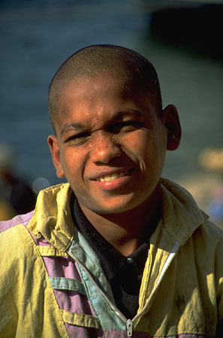
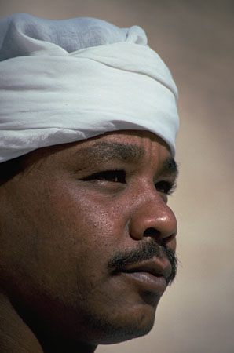

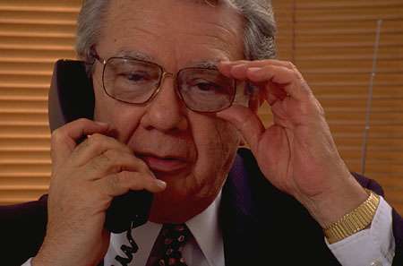
Body & Facial

Slide 6
Kinesics
The study of the communicative dimensions of facial and bodily movements.
- Includes: body movement (body language), gestures, facial expression, eye contact, and posture.

Slide 7
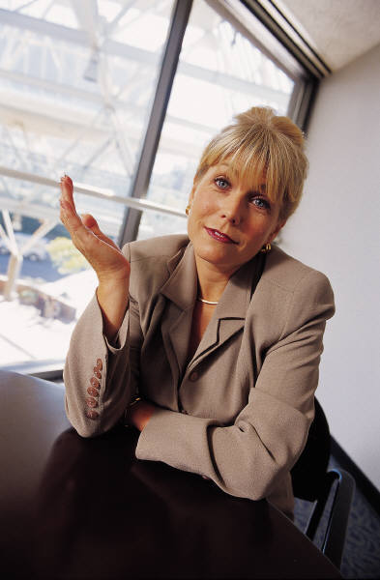
Body Gestures
Emblems
Illustrators
Adaptors

Slide 8

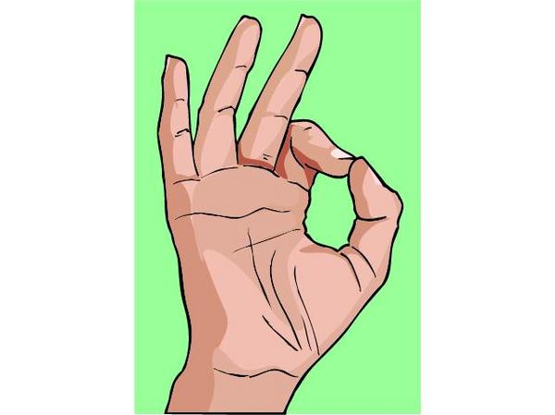

Emblems
Emblems are limited by both time and culture.

Slide 11
Posture
1) Slumped posture = low spirits
2) Erect posture = high spirits, energy and confidence
3) Lean forward = open and interested
4) Lean away = defensive or disinterested
5) Crossed arms = defensive
6) Uncrossed arms = willingness to listen
7) Hands on hips=impatient

Slide 12
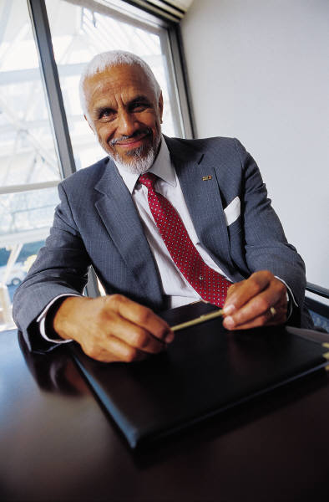
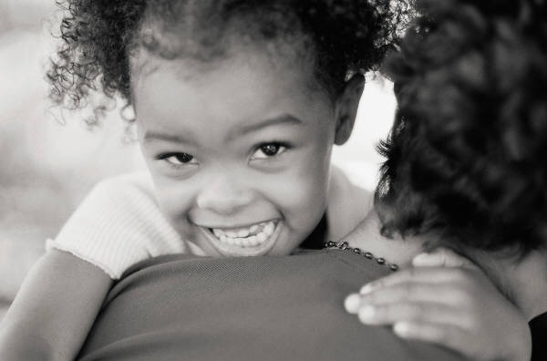
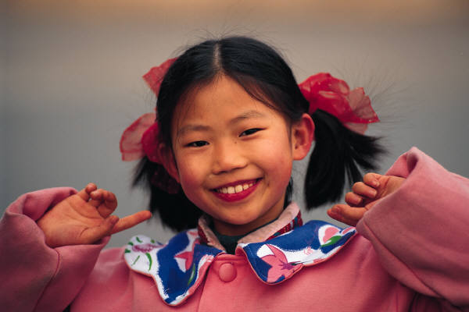
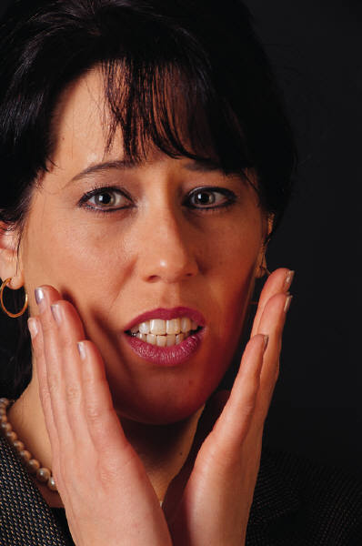
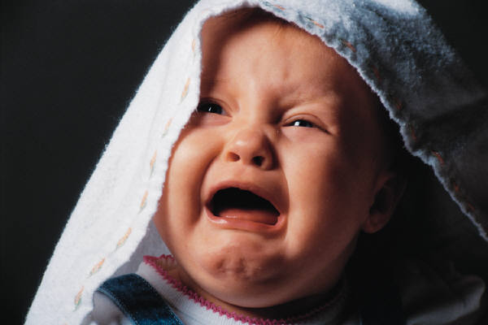
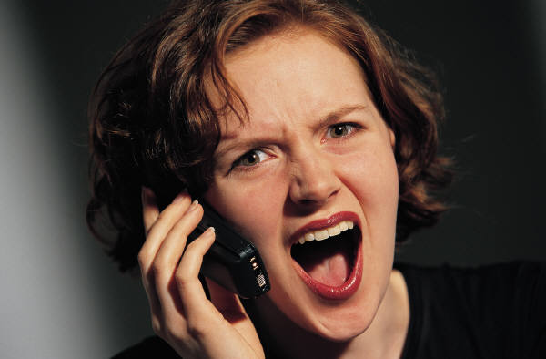
Facial Communication
Facial Management
Facial Feedback
Facial Expressions and Culture

Slide 13
Facial Management Techniques
Intensifying – to exaggerate a feeling
De-intensifying – to underplay a feeling
Neutralizing – to hide a feeling
Masking – to replace or substitute the expression of one emotion or another

Slide 14
Oculesics
Study of the way eyes are used during a communication exchange

Slide 15
3 Characteristics of Eye Messages:
Duration
Direction
Quality

Slide 16
Functions of Eye Contact
Monitor Feedback
Secure the Attention and Interest of Audience
Regulate or Control conversation
Signal Nature of Relationship

Slide 17
Eye Avoidance
Civil Inattention
Signal lack of interest
Unpleasant Stimuli
Heighten Other Senses

Slide 18
Pupil Dilation
Attractiveness
Interested
Emotionally Aroused

Slide 19
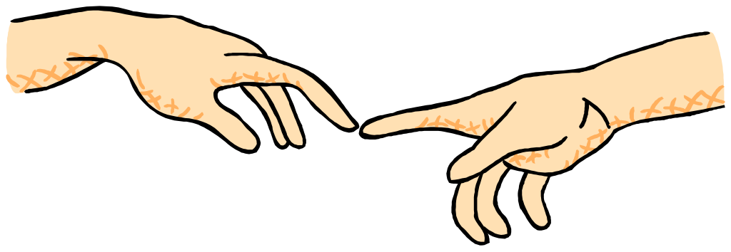
HAPTICS
The study of touch as a means of nonverbal communication
Most primitive form of communication

Slide 20
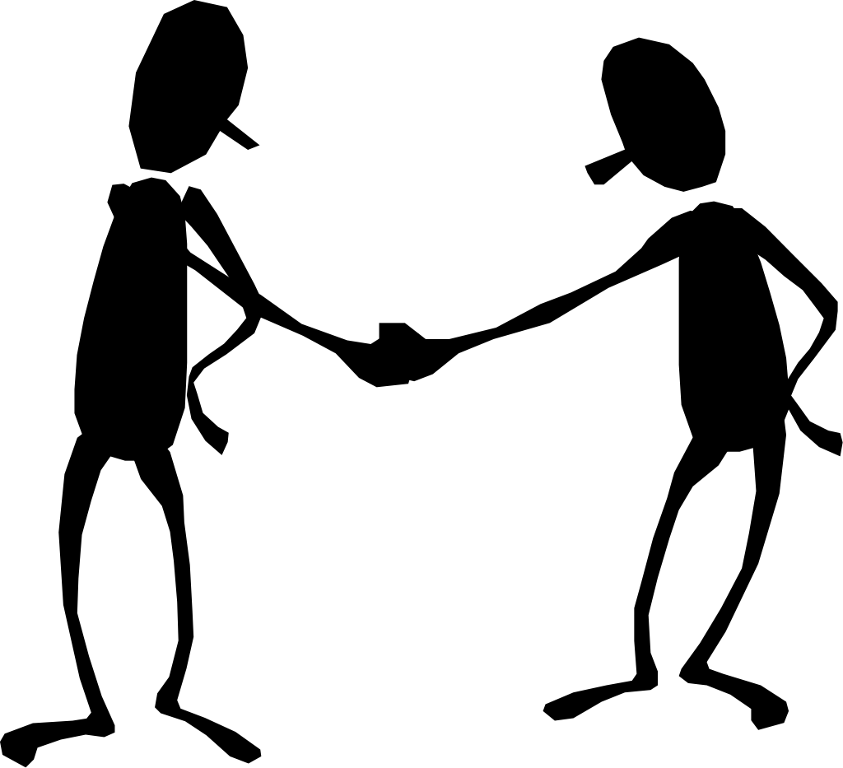
Functions of Touch:
Positive Emotions
Playfulness
Control
Ritualistic
Task Related

Slide 21
Touch Avoidance
Communication Apprehension
Self Disclosure
Gender Variation

Slide 22
Gender Differences and Touch
Cultural Differences and Touch
Mothers vs. Fathers
Same sex vs. Opposite Sex
Contact Culture
Non contact Culture

Slide 23

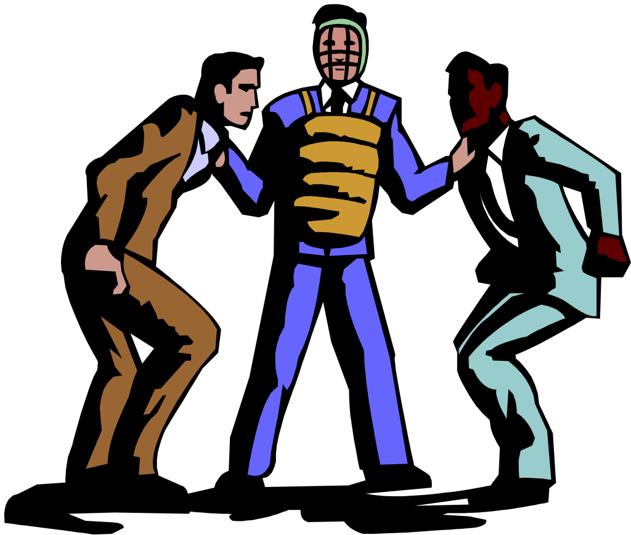
PARALANGUAGE
Paralanguage cues are used for forming impressions, for identifying emotional states, and for making judgments of credibility, intelligence, and objectivity.

Slide 24
Paralanguage is the vocal (but nonverbal) dimension of speech. It refers to the way you say something, rather than what you say.
By stressing different words in a sentence, you can change the meaning completely without doing anything to the structure of it.

Slide 25
…Silence…
Time To Think: Time to formulate responses.
Weapon To Hurt Others (the silent treatment)
Response to Personal Anxiety: Remaining silent around strangers.
Prevent Communication: A defense mechanism against saying things that you cant take back in the heat of the moment.
Communicate Emotional Responses: Pouting, Anger, Annoyance, Long Stares into another’s eyes; love.
Achieve Specific Effects: Strategically placing pauses after or before sentences to imply importance or seriousness.
Nothing To Say: Sometimes you just don’t have anything to say.

Slide 26
Proxemics
Proxemics is the study of spatial communication and how we use it (Devito)
Termed coined by founder, Edward Hall, in 1968 in his book The Silent Language
Hall’s research concluded that there are four distances we utilize in everyday interpersonal communication and these are culturally defined

Slide 27
Distances
Intimate Distance-actual touching to 6-18 inches
Personal Distance-18 inches to 4 feet
This includes the “hidden dimension” or your “personal bubble”
Social Distance- 4 to 12 feet
Public Distance-12-25 feet

Slide 28
Territory
Territory is the possessive reaction to a particular area or objects (Devito)
Primary territory—belongs to you
Boundary markers
Secondary territory—not belonging to you, but associated with you
Central markers
Public territories—areas like parks that belong to all people

Slide 29
Theories
Protection theory—people establish a buffer zone around themselves as protection against unwanted touching or attack, if threatened they want more space around them (Devito)
Equilibrium theory—greater the intimacy, the closer the distance and vice versa (Devito)
Expectancy violation theory—people expect others to maintain certain distances, when these are violated the actions are questioned (Devito)

Slide 30
Conclusion
????

